Slide 1
FrontEnds

Slide 2
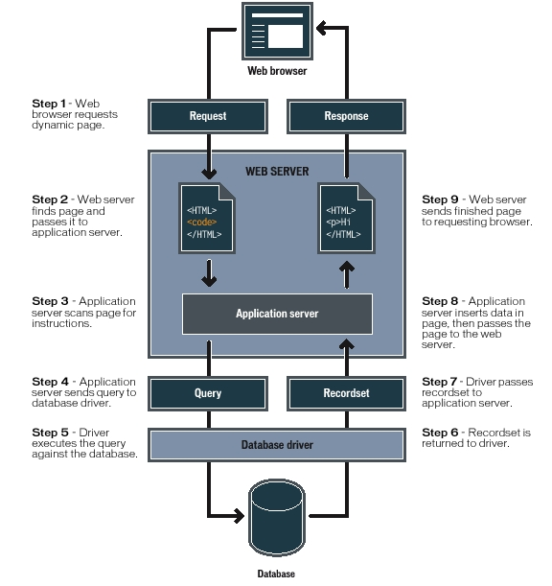
WebApps
Working
Image source

Slide 3
Front end and back end
the separation of concerns
In software engineering,
Front end refer to the presentation layer (front end),
Backend refer to the data access layer (back end) of a piece of software, or the physical infrastructure or hardware
In the client–server model,
the client is usually considered the front end
the server is usually considered the back end, even when some presentation work is actually done on the server itself.
A rule of thumb is that
the client-side (or "front end") is any component manipulated by the user
the server-side (or "back end") code usually resides on the server, often far remote from user

Slide 4
Front-end
Focus is on
User Interface elements
Mark-up and web languages such as HTML, CSS, JavaScript and supporting libraries
Asynchronous request handling and AJAX
Single-page applications (with frameworks like React, AngularJS or Vue.js)
Web performance
Responsive web design
Cross-browser compatibility issues and workarounds
End-to-end testing with a headless browser
Build automation to transform and bundle JavaScript files, reduce images size
Search engine optimization
Accessibility concerns

Slide 5
Back-end
Focus is on
Software Architecture
Application Business Logic
Application Data Access
Database management
Scripting languages like JavaScript, Node.js, PHP, Python, Ruby, Java etc.
Automated testing frameworks for the language being used
Scalability
High availability
Security concerns, authentication and authorization

Slide 6
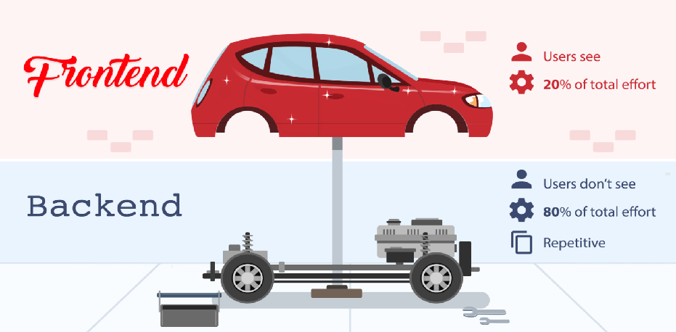
Front end – Back end
Image Source : Back4App

Slide 7
FrontEnd - Elements

Slide 8
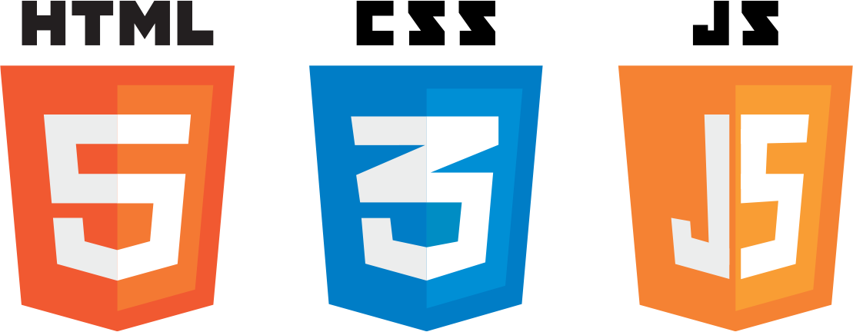
Frontend
Elements
Not just about the beautification of the web / mobile interfaces
Involves elements for
Content Structure
Styling
Interaction
Deals with
Rendering of the content on the browsers / within apps
Beautification of content rendered
Interaction carried out by user on web pages / mobile apps
Building blocks – HTML + CSS + JS!

Slide 9
Content Structure
Markup
Structure of the page is
the foundation of websites
essential for search engine optimization
vital to provide the style and the interaction that the reader will ultimately use
Hyper Text Meta Language (HTML)
will be at the very center of it all regardless of how complex the site is
uses tags, as opposed to a programming language, in order to identify all the various types of content out there on every single webpage
For example, in a newspaper article, a header, sub header, text body and other things are present
HTML works in the exact same way to label all the stuff on the webpage, except it uses HTML tags
even a JavaScript webpage, is comprised of HTML tags corresponding to each element on the webpage and every single content type is bundled into HTML tags as well.

Slide 10
Styling
Cascading Style Sheets
A core functionality of front-end development
lays out the page and give it both its unique visual flair and a clear, user-friendly view to allow readers
An important aspect of styling is checking across several browsers and to write concise, terse code that is
specific yet generic at the same time
displays well in as many renderers as possible
CSS determines how all the HTML elements must appear on the frontend
HTML gives all of the raw tools necessary to structure webpage
CSS allows to style everything so it will appear to the user exactly the way you would like it to

Slide 11
Interaction
User Interaction and interaction with backend
JavaScript
User Interaction on page
Supported by all modern browsers
employed by pretty much every website in order to gain increased functionality and power
Used mainly for website content adjustment and to make the website itself act certain ways depending on the user’s actions
Used for creating call-to-action buttons, confirmation boxes and adding new details to current information
Dynamic Behavior
drastically improves a browser’s default actions and controls
helps in placing asynchronous requests to server side and render the response received

Slide 12
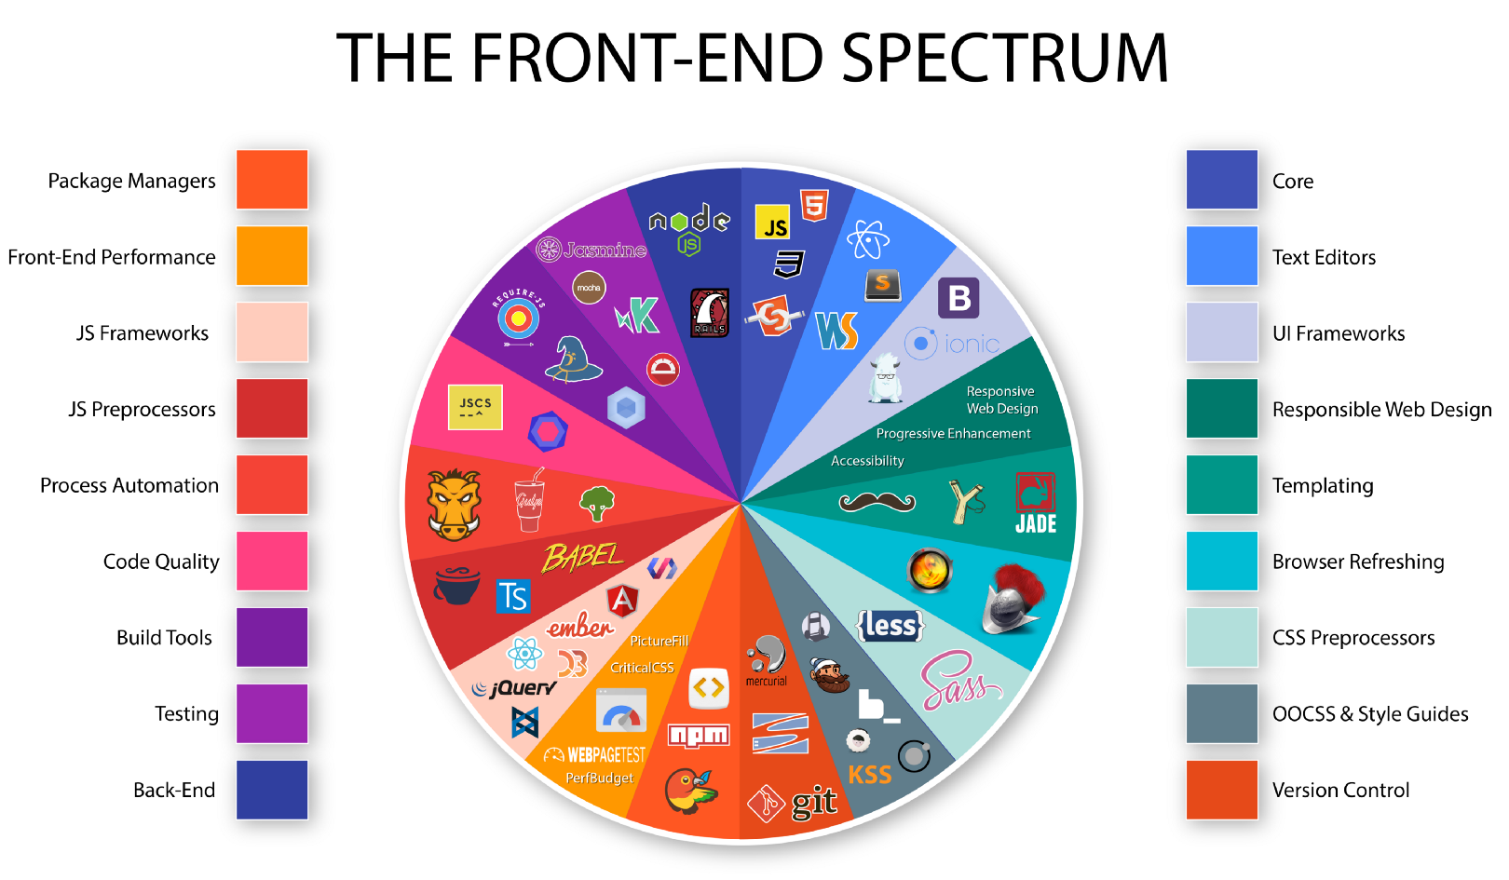
Frontend Tools Spectrum
Source : Medium

Slide 13
FrontEnd - Development

Slide 14
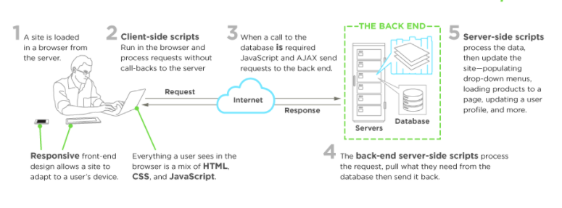
Typical Development scenario
A front-end developer
architects and develops websites and applications using web technologies (i.e., HTML, CSS, DOM, and JavaScript)
which run on the web platform or act as compilation input for non-web platform environments (i.e., NativeScript)
Image Source : upwork

Slide 15
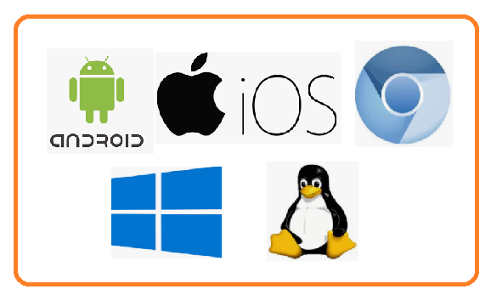
Role of a front end developer
A front-end developer crafts HTML, CSS, and JS that typically runs on the web platform (e.g. a web browser) delivered from one of the following operating systems (aka OSs):
Android
Chromium
iOS
Ubuntu (or some flavor of Linux)
Windows
These operating systems typically run on one or more of the devices:
Desktop computer
Laptop / netbook computer
Mobile phone
Tablet
TV
Watch
Things (i.e., anything you can imagine, car, refrigerator, lights, thermostat, etc.)

Slide 16
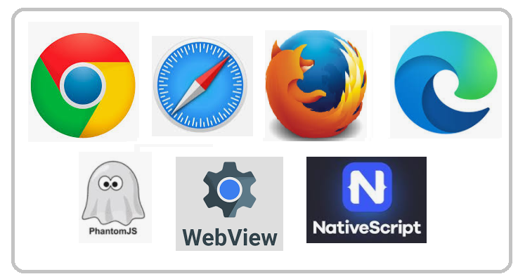
Web Platform
Front-end technologies can run on the aforementioned operating systems and devices using the following run time web platform scenarios:
A web browser (examples: Chrome, IE, Safari, Firefox).
A headless browser (examples: phantomJS).
A WebView/browser tab
A native application

Slide 17

Web Platform
Web Browsers
Is software used to retrieve, present, and traverse information on the WWW
Typically run on a desktop or laptop computer, tablet, or phone,
but as of late a browser can be found on just about anything (i.e., on a fridge, in cars, etc.).
The most common web browsers are (shown in order of most used first):
Chrome
Internet Explorer
Firefox
Safari

Slide 18

Web Platform
Headless Browsers
Are a web browser without a graphical user interface t
that can be controlled from a command line interface programmatically
Used for the purpose of web page automation
e.g., functional testing, scraping, unit testing, etc.
Think of headless browsers as a browser that can be run from the command line that can retrieve and traverse web pages
The most common headless browsers are:
PhantomJS
slimerjs
trifleJS

Slide 19

Web Platform
Webviews
Are used by a native OS, in a native application, to run web pages
Think of a webview like an iframe or a single tab from a web browser that is embedded in a native application running on a device
e.g., webviews iOS, android, windows
The most common solutions for webview development are:
Cordova (typically for native phone/tablet apps)
NW.js (typically used for desktop apps)
Electron (typically used for desktop apps)

Slide 20

Web Platform
Native from Web Tech
Web browser development can be used by front-end developers to craft code for environments that are not fueled by a browser engine
Development environments are being dreamed up that use web technologies (e.g., CSS and JavaScript), without web engines, to create native applications
Some examples of these environments are:
NativeScript
React Native

Slide 21
FrondEnd - Frameworks

Slide 22
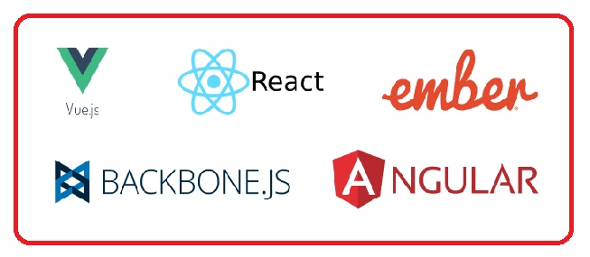
Why frameworks?
For frontend developers, it’s increasingly challenging to make up their minds about which JavaScript application framework to choose
especially when need to build a single-page application
Requirements
First, modern frontend JavaScript frameworks must respect the Web Components specification.
should have support for custom HTML elements building
Second, a solid JavaScript framework should have its own ecosystem
Ready solutions aim at solving various problems of client-side development such as
Routing
managing app state
communicating with the backend

Slide 23

React
Stormed the JS world several years ago to become its definite leader
Encourages to use a reactive approach and a functional programming paradigm
Introduced many of its own concepts to define its unique approach to frontend web development
Need to master a component-based architecture, JSX, and unidirectional data flow
Ecosystem:
The React library itself plus React-DOM for DOM manipulation
React-router for implementing routes
JSX, a special markup language that mixes HTML into JavaScript
React Create App, a command line interface that allows you to rapidly set up a React project
Axios and Redux-based libraries, JS libraries that let you organize communication with the backend.
React Developer Tools for Chrome and Firefox browsers.
React Native for development of native mobile applications for iOS and Android.

Slide 24

Angular 2
Marks a turning point in the history of the Angular framework
Has substantially changed its architecture to come to terms with React
Is from a Model-View-Whatever architecture to a component-based architecture
Ecosystem:
A series of modules that can be selectively installed for Angular projects: @angular/common, @angular/compiler, @angular/core, @angular/forms, @angular/http, @angular/platform-browser, @angular/platform-browser-dynamic, @angular/router, and @angular/upgrade
TypeScript and CoffeeScript, supersets of JavaScript that can be used with Angular
Angular command line interface for quick project setup
Zone.js, a JS library used to implement zones, otherwise called execution context, in Angular apps
RxJS and the Observable pattern for asynchronous communication with server-side apps
Angular Augury, a special Chrome extension used for debugging Angular apps
Angular Universal, a project aimed at creating server-side apps with Angular
NativeScript, a mobile framework for developing native mobile applications for iOS and Android platforms

Slide 25

Vue
At first sight, it may look like the Vue library is just a mix of Angular and React
Borrowed concepts from Angular and React
For example,
Vue wants you to store component logic and layouts along with stylesheets in one file. That’s how React works without stylesheets
To let Vue components talk to each other, Vue uses the props and state objects - existed in React before Vue adopted it
Similarly to Angular, Vue wants you to mix HTML layouts with JavaScript
The VueJS ecosystem consists of:
Vue as a view library.
Vue-loader for components.
Vuex, a dedicated library for managing application state with Vue; Vuex is close in concept to Flux.
Vue.js devtools for Chrome and Firefox.
Axios and vue-resource for communication between Vue and the backend.
Nuxt.js, a project tailored to creating server-side applications with Vue; Nuxt.js is basically a competitor to Angular Universal.
Weex, a JS library that supports Vue syntax and is used for mobile development.

Slide 26

Ember
Like Backbone and AngularJS, is an “ancient” JavaScript framework
But the fact that Ember is comparatively old doesn’t mean that it’s out of date
Allows implement component-based applications just like Angular, React, and Vue do
One of the most difficult JavaScript frameworks for frontend web development
Realizes a typical MVC JavaScript framework, and Ember’s architecture comprises the following parts:
adapters, components, controllers, helpers, models, routes, services, templates, utils, and addons.
The EmberJS ecosystem includes:
The actual Ember.js library and Ember Data, a data management library.
Ember server for development environments, built into the framework.
Handlebars, a template engine designed specifically for Ember applications.
QUnit, a testing JavaScript framework used with Ember.
Ember CLI, a highly advanced command line interface tool for quick prototyping and managing Ember dependencies.
Ember Inspector, a development tool for Chrome and Firefox.
Ember Observer, public storage where various addons are stored. Ember addons are used for Ember apps to implement generic functionalities.

Slide 27

Backbone/Marionette
Is an MV* framework. Backbone partly implements an MVC architecture, as Backbone’s View part carries out the responsibilities of the Controller
Has only one strong dependency – the Underscore library that gives us many helper functions for convenient cross-browser work with JavaScript
Attempts to reduce complexity to avoid performance issues
The BackboneJS ecosystem contains:
The Backbone library, which consists of events, models, collections, views, and router
Underscore.js, a JavaScript library with several dozen helper functions that you can use to write cross-browser JavaScript
Underscore’s microtemplating engine for Backbone templates
BackPlug, an online repository with a lot of ready solutions (Backbone plugins) tailored for Backbone-based apps
Backbone generator, a CLI for creating Backbone apps
Marionette, Thorax, and Chaplin – JS libraries that allow you to develop a more advanced architecture for Backbone apps

Slide 28
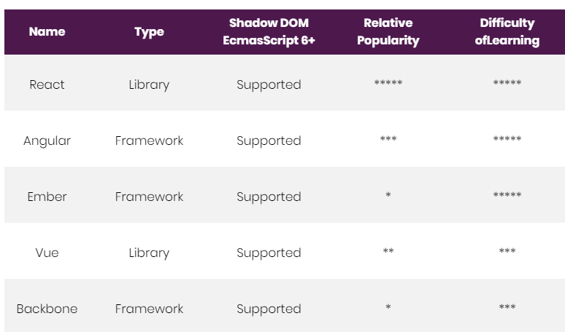
Compared
Source : RubyGarage

Slide 29
Backend

Slide 30
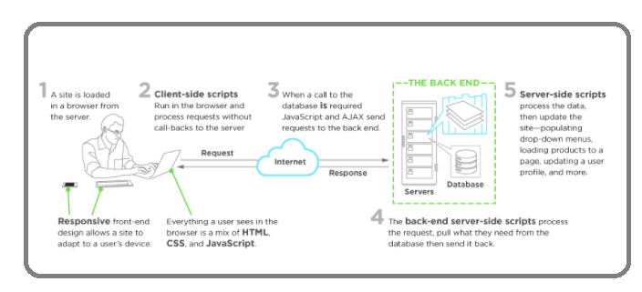
Server side
Interaction between front-end and back-end
To understand server side, one need to know the front end and how the two interact
Image : Upwork

Slide 31
Server side
Interaction Explained
The front end is what happens in the browser—everything the end users see and interact with
The back end, on the other hand, happens on the server
on site, or in the cloud
databases
Machinery that works behind the scenes—everything the end user doesn’t see or directly interact with, but that powers what’s happening!
Server-side manages all those requests that come from users’ clicks
Front-end scripts sends those requests over to the server side to be processed, returning the appropriate data to the front end
Often happens in a constant loop of requests and responses to the server

Slide 32
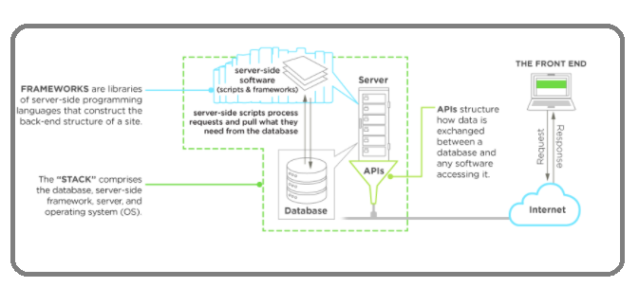
Server side architecture
Components
Server (web / application server)
Database
Operating System
API
Image : Upwork

Slide 33
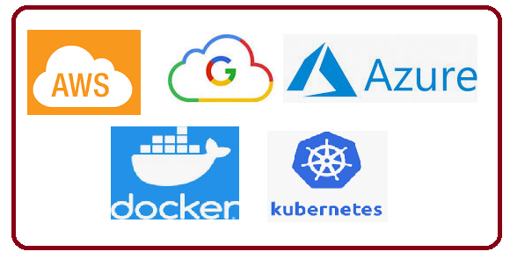
Server side architecture
Components
The “traditional” back end was simple
Mix of the server, databases, APIs, and operating systems that power an app’s front end
The back end of applications can look very different from application to application based upon
frameworks
cloud-based servers
containerization with a service like Docker
Backend-as-a-Service (BaaS) providers
APIs to replace more complex processing

Slide 34
Backend - Components

Slide 35
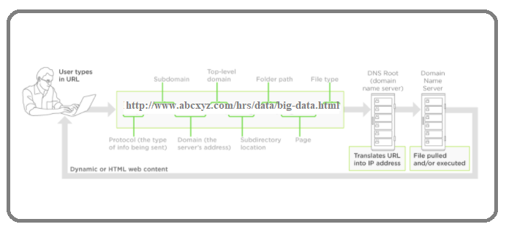
Server side Components
Servers: The machinery
Server acts as the lifeblood of the network
Can be on-site or in the cloud
High-powered computers provide shared resources that need to run for application
file storage
security and encryption
databases
email
web services
Image : Adapted from Upwork

Slide 36
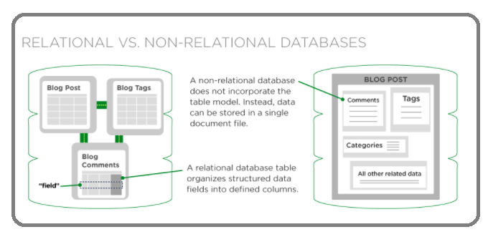
Server side Components
Databases: The brains
Are the brains that make websites dynamic
Is responsible for accepting that query, fetching the data, and returning it to the website
Searching for a product in on online store
Searching for hotel locations within a specific state
Accepts new and edited data when users of a website or application interact with them
The client can change information in a database from the browser such as
posting articles to a CMS
uploading photos to a social media profile
updating their customer information
Image : Upwork

Slide 37
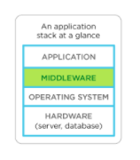
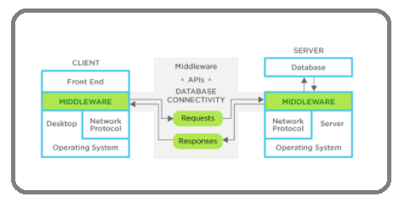
Server side Components
Middleware: The plumbing
Any software on the server that connects an application’s front end to its back end
Think of it as plumbing for your site
pipes any communication, like requests and responses, back and forth between your application and server/database
you don’t see middleware, but it’s there and it has to be reliable and always do what’s expected of it
Middleware (server-side software) facilitates client-server connectivity, forming a middle layer between the app(s) and the network
Can be multi-layered, organized into different layers of a site, whether it’s the presentation layer or the business layer
Web APIs can play into the stack, providing a bridge between the business layer and presentation layer
Image : Upwork

Slide 38
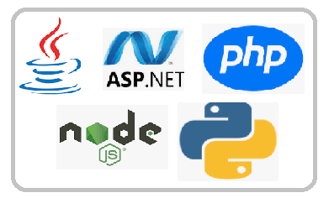
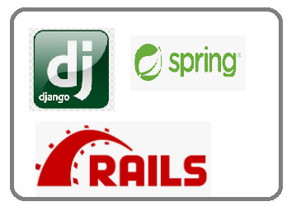
Server side Components
Programming languages & frameworks: The nuts & bolts
Can choose from a variety of languages and frameworks depending on
the type of application being built
the specific processing requirements
other components already exist on the back end
Languages will differ in file size, performance, compatibility, how many lines of code required, and the style of programming
Some back-end scripting languages are object-oriented programming languages
Other languages may be compiled rather than interpreted
affects load time, readability, and processing power required to run the application
Big hitters in back-end programming, like:
Java
C# and C++
.NET
Perl
Scala
Node.js
Frameworks that developers use as scaffolding to build server-side applications
Django (for Python)
Spring framework (for Java)
Node.js including MeteorJS and ExpressJS (for JavaScript with Node.js)
Ruby on Rails
Symfony (for PHP)

Slide 39
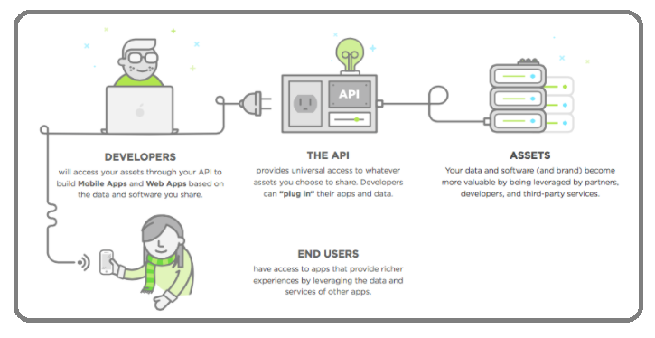
Server side Components
APIs: Crucial tech in Back-End programming
Can’t talk about the back-end portion of an application these days without touching on APIs (application programming interfaces)
Connect software, applications, databases, and services together seamlessly
Plays an integral role in how most server-side software architectures are built
Replacing more complicated programming to allow software to communicate and data to be transferred
Image : Upwork

Slide 40
Backend - WebServers

Slide 41
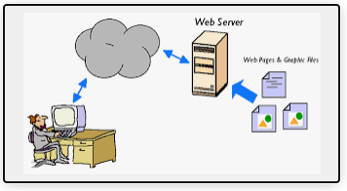
Web Server
Defined
All computers that host websites must have web server software
Software and hardware that uses HTTP (Hypertext Transfer Protocol)to respond to client requests made over the World Wide Web
Main job of a web server is to display website content through storing, processing and delivering webpages to users
Also support SMTP (Simple Mail Transfer Protocol) and FTP (File Transfer Protocol), used for email, file transfer and storage
Web server hardware is connected to the internet and allows data to be exchanged with other connected devices
software controls how a user accesses hosted files
Used for
web hosting
hosting of data for websites
web applications

Slide 42
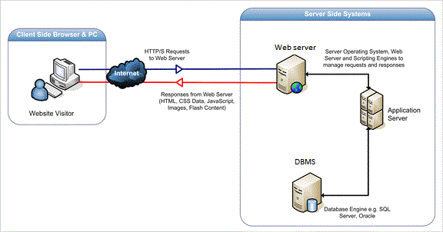
Web Server
Working
Accessed through the domain names of websites and ensures the delivery of the site's content to the requesting user
The software side at least an HTTP server - understand HTTP and URLs
The hardware side, a computer that stores web server software and other files related to a website, such as HTML documents, images and JavaScript files
A user needs a file hosted on web server
A person will specify a URL in a web browser's address bar
The web browser will then obtain the IP address of the domain name -- translating the URL through DNS (Domain Name System)
The browser will then request the specific file from the web server by an HTTP request
When the request is received by the web server,
the HTTP server will accept the request
find the content
send it back to the browser through HTTP
If the requested page does not exist or if something goes wrong, the web server will respond with an error message. The browser will then be able to display the webpage.
Image source : stackoverflow

Slide 43
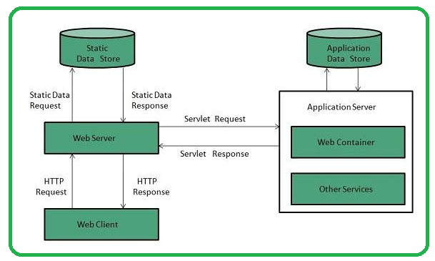
Web Server - Types
Dynamic vs. static web servers
A web server can be used to serve either static or dynamic content
Static refers to the content being shown as is
Dynamic content can be updated and changed
A static web server
Consist of a computer and HTTP software
Considered static because the sever will send hosted files as is to a browser
Dynamic web server
Consist of a web server and other software such as an application server and database
Considered dynamic because the application server can be used to update any hosted files before they are sent to a browser
Can generate content when it is requested from the database
Process is more flexible, it is also more complicated
Image Source : TutorialsPoint

Slide 44




Common Web servers
Apache HTTP Server
Developed by Apache Software Foundation
Free and open source web server
For Windows, Mac OS X, Unix, Linux, Solaris and other operating systems
Microsoft Internet Information Services (IIS)
Developed by Microsoft for Microsoft platforms
Not open sourced, but widely used
Nginx
A popular open source web server for administrators
Has very light resource utilization and scalability
Can handle many concurrent sessions due to its event-driven architecture
Can be used as a proxy server and load balancer
Sun Java System Web Server
A free web server from Sun Microsystems that can run on Windows, Linux and Unix
Well-equipped to handle medium to large websites

Slide 45
Backend - Server Side Scripting

Slide 46
Server Side Scripting
A technique used in web development which involves employing scripts on a web server
which produce a response customized for each user's (client's) request to the website
Scripts can be written in server-side scripting languages
PhP
Python
JSP
ASP .net
Java
Is often used to provide a customized interface for the user
Scripts may assemble client characteristics for use in customizing the response based on those characteristics, the user's requirements, access rights, etc.
Enables the website owner to hide the source code that generates the interface, whereas with client-side scripting, the user has access to all the code received by the client
A down-side to the use of server-side scripting is that the client needs to make further requests over the network to the server in order to show new information to the user via the web browser

Slide 47
Server-side script basics
Runs on a server, embedded in the site’s code
Facilitates the transfer of data from server to browser, bringing pages to life in the browser
Designed to interact with back-end permanent storage, like databases,
Runs on-call. When a webpage is “called up,” or when parts of pages are “posted back” to the server with AJAX, server-side scripts process and return data
Powers functions in dynamic web applications
user validation
saving and retrieving data
navigating between other pages
Build application programming interfaces (APIs)
which control what data and software a site shares with other apps

Slide 48
Popular server-side languages
PHP
The most popular server-side language on the web, PHP is designed to pull and edit information in the database
Most commonly bundled with databases written in the SQL language
PHP-powered sites: WordPress, Wikipedia, Facebook
Python
With fewer lines of code, is fast, making it ideal for getting things to market quickly
Emphasis is on readability and simplicity, which makes it great for beginners
The oldest of the scripting languages, is powerful, and works well in object-oriented designs
Python-powered sites: YouTube, Google, The Washington Post
Ruby
Handles complicated logic on the database side of site vrey well
Great for startups, easy maintenance, and high-traffic demands
Requires developers to use the Ruby on Rails framework, which has vast libraries of code to streamline back-end development
Ruby-powered sites: Hulu, Twitter (originally), Living Social, Basecamp

Slide 49
Popular server-side languages
C#
Language of Microsoft’s .NET Framework—the most popular framework on the web
Combines productivity and versatility by blending the best aspects of the C and C++ languages
Excellent for developing Windows applications, and can be used to build iOS, Android mobile apps with the help of a cross-platform technology like Xamarin
Java
Comes with a huge ecosystem of add-on software components
“Compile once, run anywhere” is its motto
Excellent for enterprise-level applications, high-traffic sites, and Android apps
Java sites: Twitter, Verizon, AT&T, Salesforce

Slide 50
Backend - Server Side Scripting

Slide 51
Server Side Scripting
A technique used in web development which involves employing scripts on a web server
which produce a response customized for each user's (client's) request to the website
Scripts can be written in server-side scripting languages
PhP
Python
JSP
ASP .net
Java
Is often used to provide a customized interface for the user
Scripts may assemble client characteristics for use in customizing the response based on those characteristics, the user's requirements, access rights, etc.
Enables the website owner to hide the source code that generates the interface, whereas with client-side scripting, the user has access to all the code received by the client
A down-side to the use of server-side scripting is that the client needs to make further requests over the network to the server in order to show new information to the user via the web browser

Slide 52
Server-side script basics
Runs on a server, embedded in the site’s code
Facilitates the transfer of data from server to browser, bringing pages to life in the browser
Designed to interact with back-end permanent storage, like databases,
Runs on-call. When a webpage is “called up,” or when parts of pages are “posted back” to the server with AJAX, server-side scripts process and return data
Powers functions in dynamic web applications
user validation
saving and retrieving data
navigating between other pages
Build application programming interfaces (APIs)
which control what data and software a site shares with other apps

Slide 53
Popular server-side languages
PHP
The most popular server-side language on the web, PHP is designed to pull and edit information in the database
Most commonly bundled with databases written in the SQL language
PHP-powered sites: WordPress, Wikipedia, Facebook
Python
With fewer lines of code, is fast, making it ideal for getting things to market quickly
Emphasis is on readability and simplicity, which makes it great for beginners
The oldest of the scripting languages, is powerful, and works well in object-oriented designs
Python-powered sites: YouTube, Google, The Washington Post
Ruby
Handles complicated logic on the database side of site vrey well
Great for startups, easy maintenance, and high-traffic demands
Requires developers to use the Ruby on Rails framework, which has vast libraries of code to streamline back-end development
Ruby-powered sites: Hulu, Twitter (originally), Living Social, Basecamp

Slide 54
Popular server-side languages
C#
Language of Microsoft’s .NET Framework—the most popular framework on the web
Combines productivity and versatility by blending the best aspects of the C and C++ languages
Excellent for developing Windows applications, and can be used to build iOS, Android mobile apps with the help of a cross-platform technology like Xamarin
Java
Comes with a huge ecosystem of add-on software components
“Compile once, run anywhere” is its motto
Excellent for enterprise-level applications, high-traffic sites, and Android apps
Java sites: Twitter, Verizon, AT&T, Salesforce

Slide 55
Backend - TechStacks

Slide 56
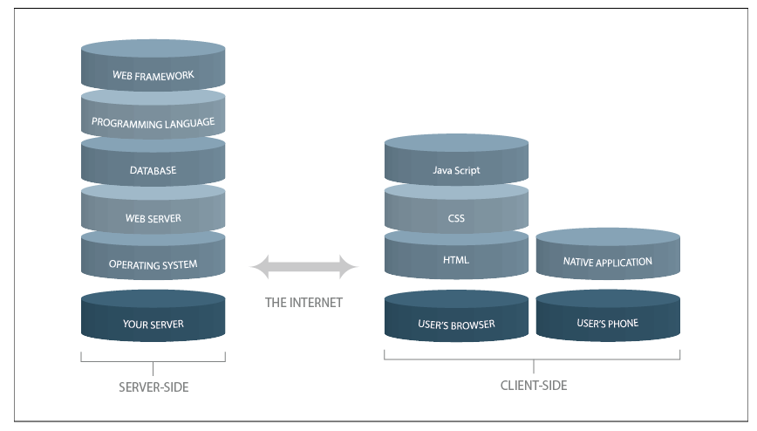
Tech stack
Is the combination of programming languages, tools and frameworks that the developers use to create web and mobile applications
Two main components to any application, known as client side and server side, also popular as front end and back end
A stack is created when one layer of application is built atop the other
with the help of codes and hardware modules ranging from generic to specific
A stack contains different layers of components/servers that developers use to build software applications and solutions
Image source : hackernoon

Slide 57
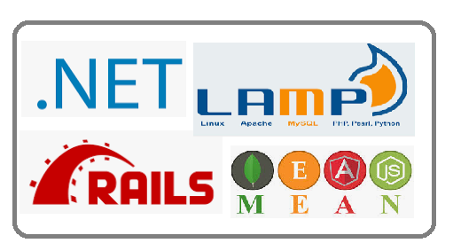
Tech stack
Deciphered
Client-side
Is where the real interaction with the user happens
The user will interact with the website, the web app or a mobile app depending on what he is using
Three main technologies in front end: HTML, CSS and JavaScript
Server-side
The back end consists of a server, an application (OS, Web server, Programming language, Web framework), and a database
Umbrella term used for websites where developers perform the following functions like
programming the business logic
server side hosting
app deployments
integrating with databases
Common Stacks
.net
LAMP
MEAN / MERN / MEVN / MEEN
RoR

Slide 58
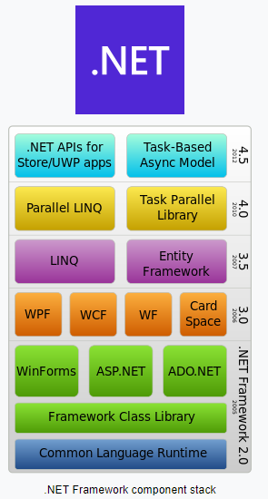
.net stack
Developed by Microsoft
Is a feature rich, thoroughly battle tested framework that lets to build dynamic and interactive web apps
Subset of Overflow Stack, a comprehensive tech stack that fulfils all the requirements of web front-end, database and .NET developers
C# language and .NET framework form the centerpiece
Capable of supporting a wide variety of applications
right from small scale server side web applications
to huge enterprise-level, transaction processing systems
.NET Stack has about 60 frameworks, platforms, SDKs, IDEs, SOA, libraries, etc. spread over 13 layers
Image source : wikipedia

Slide 59
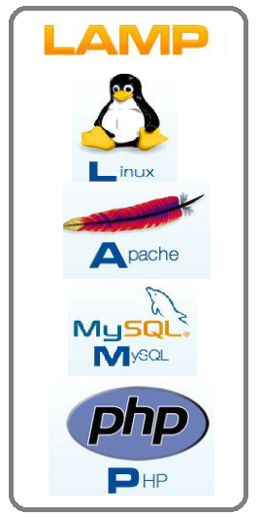
LAMP
Linux, Apache, MySQL, Python / Perl/ Php
Made of all open source software components is the one of the earliest stacks to get popular
The most traditional stack model around, and very solid
The main components are
Linux operating system,
Apache HTTP Server
MySQL RDBMS
PHP programming language
PHP is interchangeable with the languages Perl and Python.
Variations of LAMP include:
WAMP (Windows/Apache/MySQL/PHP): uses IIS server.
LAPP (Linux/Apache/PostgreSQL/PHP):uses PostgreSQL database variation that’s configured to work with enterprise-level projects
MAMP (Mac OS X/Apache/MySQL/PHP): Mac OS X operating system variation
XAMP (Linux, Mac OS X, Windows/Apache/MySQL/PHP, Perl): More complete bundle, and runs on Linux, Windows, and Mac operating systems

Slide 60
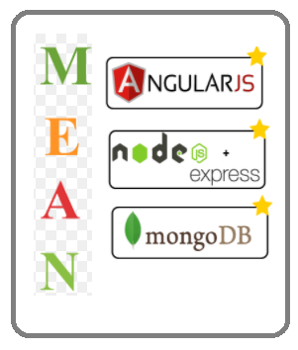
ME(A/R/V)N Stack
MongoDB, Express, Angular, Node
Open source, free Javascript software stack developers use for building dynamic web apps and websites
Supports MVC pattern
Components are
MongoDB — a NoSQL database
Express.js — a web app framework that runs on Node.js
Angular JS (or Angular) Javascript MVC framework that run in browser JavaScript engines
Node.js — an execution domain for event-driven server-side
Programs are coded in JavaScript - helps language uniformity
Makes it easier for developer working on the client side, understand the codes of the server side
Uses JSON for data transfer
The variation of MEAN include:
MERN: MongoDB, Express.js, React.js and Node.js
MEVN: MongoDB, Express.js, Vue.js and Node.js.
MEEN: MongoDB, Express.js, Ember.js and Node.js

Slide 61

Ruby on Rails
Facilitates quick app development thanks to its rich repository of gems — library integrations
Highly scalable and it follows the ActiveRecord pattern
Compatible with MySQL on the back end.
Has its own built in database
Can abstract away the lower data base commands
Can write the codes in Active Record syntax and then swap it with lower level database specific queries
Useful when you don’t use too much database specific queries

